Slide 1

Presentation On Windows Firewall
By Abdur Razzak
ID: 1204149
Batch: ID-NT/ACSL-01M/R28/01
Date: 19/06/2016

Slide 2
Windows Firewall
Windows Firewall is a software component of Microsoft Windows that provides firewalling and packet filtering functions.
A firewall can help prevent hackers or malicious software (such as worms) from gaining access to your computer through a network or the Internet.
A firewall can also help stop your computer from sending malicious software to other computers.

Slide 3

Introducing Windows Firewall
It was first included in Windows XP and Windows Server 2003.
Prior to the release of Windows XP Service Pack 2 in 2004, it was known as Internet Connection Firewall.

Slide 4
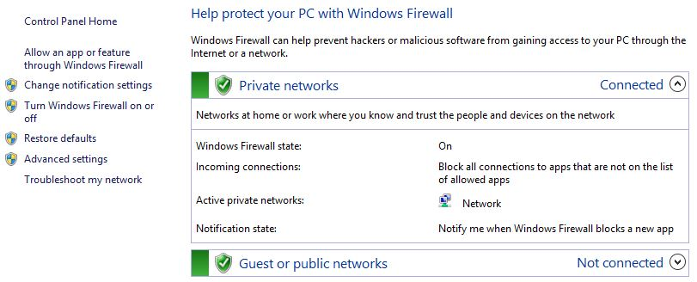
Type of Firewall
Windows supports two firewall applications, Windows Firewall and Windows Firewall with Advanced Security.
Windows Firewall can help protect an individual computer from harmful or unnecessary traffic.
It allows for a simpler configuration set than Windows Firewall with Advanced Security, which provides granular control of specific ports and other options.

Slide 5
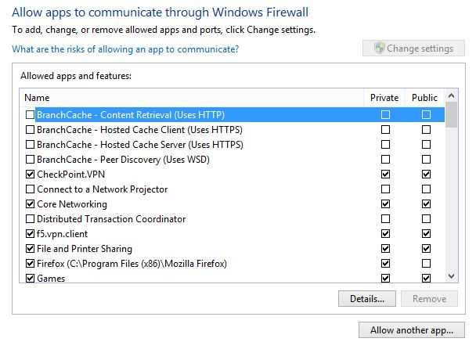
Allow An App Or Feature Through Windows Firewall
This option enables administrators to configure the firewall based on applications that need specific access.
You can also remove an app that you have previously granted access through the firewall.

Slide 6
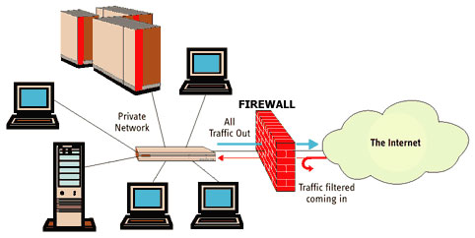
Firewall with Advanced Security
Windows Firewall with Advanced Security is a host-based, stateful firewall included in Windows Server 2012 and Windows 8.
The feature was introduced in Windows Vista and Windows Server 2008, and its functionality has been enhanced in several ways in later Windows versions.

Slide 7
A Host-Based Firewall
Host-Based Firewalls are equally important for both client and server systems because they provide an additional layer of protection.
Host-Based Windows Firewall with Advanced Security is designed to protect the local computer, unlike a perimeter network firewall, witch is designed to protect the network itself.
However, to protect a network, you also to protect each computer on the network because even if a single computer is compromised, it could provide an attacker with a way to compromised the rest of the network.

Slide 8
A Stateful Firewall
A Stateful Windows Firewall with Advanced Security can keep track of the state of packets as they travel across the network.
Packets that match a specified rule can be either allowed or denied depending on how the rule has been configured.
Windows Firewall with Advanced Security can inspect and filter both inbound and outbound packets, and it supports both Internet Protocol version 4 (IPv4) and version 6 (IPv6)

Slide 9
Firewall Profiles
Domain Profile: This profile is automatically applied to any network connection that Windows identifies as having a network location type of domain.
Private Profile: This profile is automatically applied to any network connection that Windows identifies as having a network location type of private.
Public Profile: This profile is automatically applied to any network connection that Windows identifies as having a network location type of public.

Slide 10
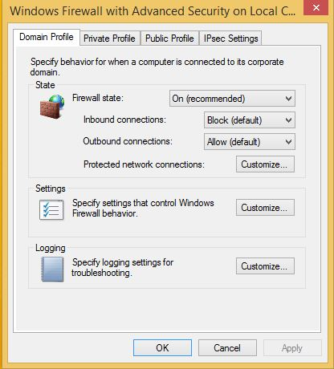
Configuring Profiles
By default, all three firewall profiles are enabled on Windows computer. You can change the state of any profile or configure:
Firewall State
Inbound Connections
Block
Block All Connections
Allow
Outbound Connections
Protected Network Connections

Slide 11
Firewall Rules
A rule is basically a set of criteria that determines whether a network packet should be handled.
The two basic types of rules you can configure in Windows Firewall with Advanced Security are:
Firewall rule: A set of criteria that specifies whether a particular type of traffic passing between the local computer and other computers on the network should be accepted (passed) or rejected (blocked).
Connection security rule: A set of criteria that specifies how traffic passing between the local computer and other computers on the network should be protected using IPsec.

Slide 12
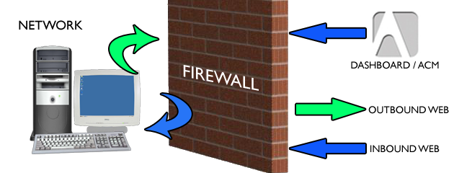
Types of Firewall Rules
Inbound rule: A rule that specifies how incoming network traffic should be handled—that is, traffic originating from other computers and having the local computer as its destination.
Outbound rule: A rule that specifies how outgoing network traffic should be handled—that is, traffic originating from the local computer and having other computers or network devices as its destination.

Slide 13
Types of Firewall Rules
Both inbound and outbound rules can be configured to either allow (permit) or deny (block) traffic based on the criteria contained in the rule. Because there are many types of network traffic possible, Windows Firewall with Advanced Security also has special rules called default rules that determine how traffic should be handled when it doesn’t match any of the criteria contained in any of the inbound and outbound rules.
Inbound default rule: Block all traffic originating from other computers and having the local computer as its destination
Outbound default rule: Allow all traffic originating from the local computer and having other computers or network devices as its destination

Slide 14
Creating Firewall Rules
Program rule: This is a rule that specifies how traffic associated with a specific program (executable) running on the local computer should be handled.
Port rule: This is a rule that specifies how traffic associated with a specific TCP or UDP port or port range on the local computer should be handled.
Predefined rule: This is a rule that specifies how traffic associated with a specific Windows feature or service running on the local computer should be handled.
Custom rule: This is a rule that specifies how traffic should be handled based on any of the traffic-filtering criteria supported by Windows Firewall with Advanced Security.

Slide 15
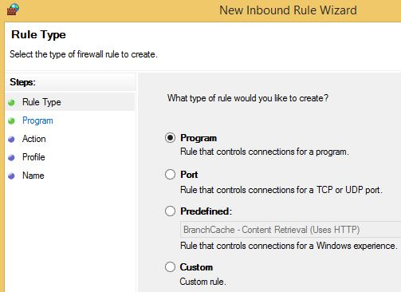
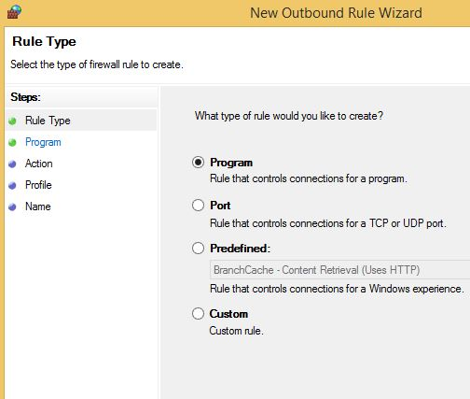
Creating Firewall Rules

Slide 16
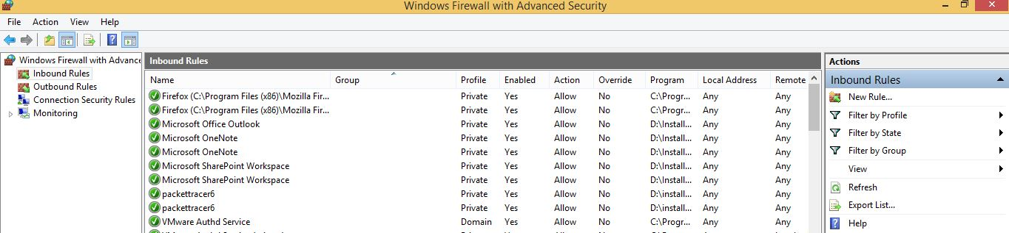
Managing Firewall Rules
Enable: Use this option to enable a rule that is currently disabled.
Disable: Use this option to disable a rule that is currently enabled.
Delete: Use this option to delete a rule that is no longer needed.
Properties: Use this option to open the properties of the rule and configure any editable criteria for the rule.

Slide 17
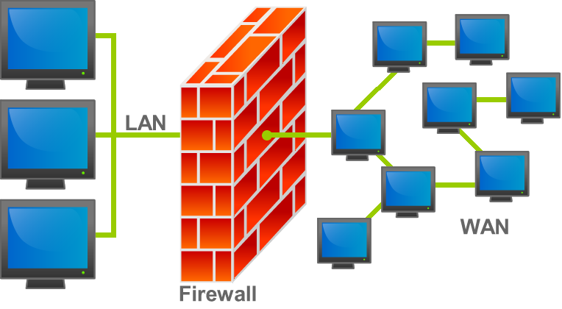
Thank you…
The End.

